Slide 1



International Financial Services Centre in GIFT City:
IFSCA CPSE Summit 2.0: Opportunities in GIFT IFSC
7th February 2025
International Financial Services Centre Authority
Ministry of Finance, Government of India
GIFT City, Gujarat, India
www.ifsca.gov.in

Slide 2
GIFT City and IFSC
India's 1st Operational Smart City & IFSC
27.70 Mn Sq ft
12.99 Mn Sq ft
20
Total development
rights allotted
Area under
development
Number of Operational Buildings
GIFT City is divided into two zones:
Special Economic Zone (IFSC Zone)
Domestic Tariff Area (Domestic area)
Greenfield smart city
Land parcel size: 886 acres
Social Infra – Hotels, Hospitals, Schools, etc
‘Walk to work concept’ – Residential & Riverside

Slide 3
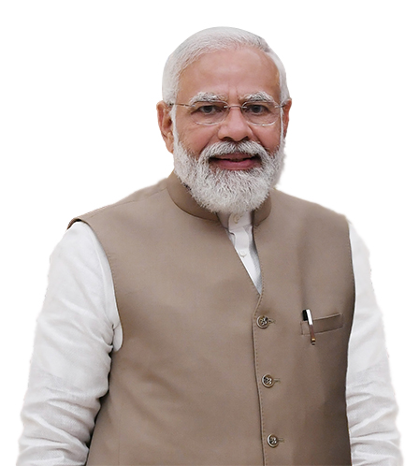

Vision for GIFT IFSC
“We want to make GIFT City the Global Nerve Center of New Age Global Financial and Technology Services”
“GIFT IFSC's cutting-edge digital infrastructure provides a platform that enables businesses to increase efficiency”
“GIFT City is an important gateway to connect India with global opportunities….
Hon’ble Prime Minister of India
Sh. Narendra Modi

Slide 4
Objectives of GIFT IFSC
Onshore international financial services business from offshore centres such as Singapore, Hong Kong, Dubai, London, etc.
Serve as a dominant gateway for channelizing global capital for Viksit Bharat @ 2047
Develop expertise in niche and specialized businesses such as aircraft & ship leasing, fintech, global treasury centres, commodity trading, etc.
Provide high quality employment opportunities to the talented Indian workforce
1
Aims & Objectives
2
3
4

Slide 5
Jurisdictional Comparison
Foreign jurisdiction (rest of the world) | IFSC SEZ (India) | India DTA (India)
Offshore Non-Resident | Offshore Non-Resident | Onshore Resident
Respective Int’l Currency | 15 Currencies (INR Not Permitted) | INR denominated
Offshore | Tax Holiday (Tax Resident) | Taxes as applicable
Resident’s Jurisdiction | Indian Jurisdiction (Carve Outs) | Indian Jurisdiction
Jurisdiction
FEMA
Currency
Tax
Law

Slide 6


GIFT IFSC: Unique and Distinct Features
Dedicated & Unified Financial Regulator
No capital controls
Full Convertibility with 15 foreign currencies
Globally benchmarked regulations
Attractive Tax Regime
Sovereign support, including carve outs
Competitive Advantage
  Access to large hinterland Indian economy (Hinterland advantage)
  Beneficial cost of operations (Cost advantage)
  Availability of skilled talent pool (Talent advantage)

Slide 7
Regulatory architecture
Regulations Benchmarked with Global Best Practices
Banking Regulations 2020
Bullion Exchange Regulations 2020
Global In-House Regulations 2020
FinTech Entity Framework 2022
Issuance and Listing of Securities Regulations, 2021
Finance Company Regulations, 2021
Market Infrastructure Institutions Regulations 2021
Framework for Aircraft Lease 2022
Framework for Ancillary Services 2021
Framework for Global Corporate Treasury Centres 2021
Fund Management (Regulations) 2022
Capital Market Intermediaries Regulations 2021
Registration of Insurance Business Regulations 2021
Insurance Intermediary Regulations 2021
Framework for setting up ITFS 2021
Framework for Ship Lease 2022
Foreign University Regulations 2022
AML, CFT and KYC Guidelines 2022
Insurance Products and Pricing Regulations 2022
Payment & Receipt of Premium Regulations 2022
Insurance Web Aggregator, 2022
Investment by IFSC Insurance Office Regulations 2022
Framework for Global Administrative Office 2022
Re-Insurance Regulations 2023
Notes:
GIFT City – Brief

Slide 8





































Key Entities in GIFT IFSC and GIFT City
Banking
Funds Industry
Service Provider
Other Entities
Firms in DTA

Slide 9
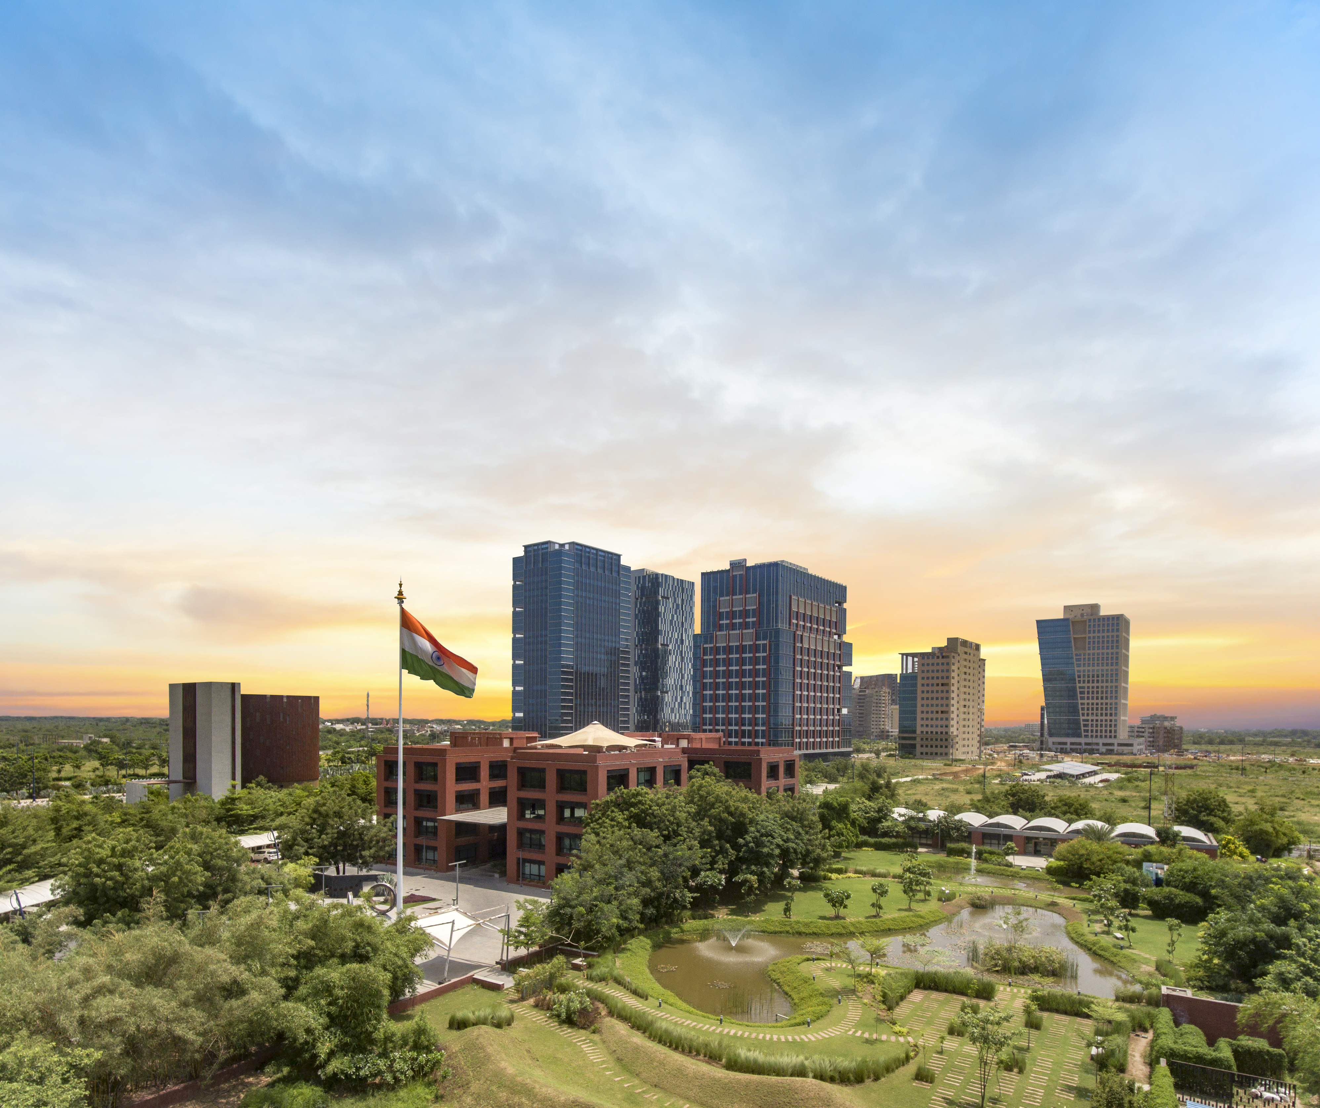
Competitive tax regime
1
Tax Holiday on Business Income for 10 out of 15 years
2
Minimum Alternate Tax* @ 9%
3
No CTT**/STT**/GST**/Stamp Duty
4
Reduced Withholding Tax of 9% on interest paid on Debt Instruments
5
Competitive Tax Regime for Funds
6
Incentives under Gujarat IT/ITeS Policy (2022-27)
*MAT provisions not applicable for companies opting for concessional tax rate under Sec. 115 BA of Income Tax Act, 1961
**CTT- Commodity Transaction Tax, STT- Securities Transaction Tax, GST- Goods and Service Tax
Notes:
GIFT City – Brief

Slide 10
Business Growth Across Various Verticals (1)
Upto Sept. 2020
Upto Dec. 2024
Growth
IFSC Entities
Before IFSCA
After IFSCA
1. IFSCA Registered Entities*
129
750 +
621(481%)
Banking
14
28
14 (100%)
2. Number of Banks
3. Total Banking Asset Size
$ 14 Bn
$ 78.3 Bn
$ 64.3 Bn (460%)
4. Total Banking Transactions
$ 53 Bn
$ 1095 Bn
$ 1042 Bn (1966%)
NA
5
5
5. Payment service Providers
* Including entities registered, licensed or authorized

Slide 11
Business Growth Across Various Verticals (2)
Upto Sept. 2020
Upto Dec. 2024
Growth
Capital Markets
Before IFSCA
After IFSCA
$ 23 Bn
$ 63.6 Bn
$ 40 Bn+ (173%)
6. Total Debt Listing on Exchanges
$ 2.1 Bn
$ 15.4 Bn
$ 13 Bn+ (619%)
7. Out of which, ESG Debt Listing
$ 21.7 Bn
$ 85 Bn
$ 63 Bn+ (290%)
8. Monthly Turnover on IFSC Exchanges
FinTech
NA
44
44
9. Sandbox Entities
NA
12
12
10. FinTechs/TechFins Authorized
NA
2
2
11. Accelerators Authorized
*6 FinTech entities exited the Sandbox in last 6 months

Slide 12
Business Growth Across Various Verticals (3)
Insurance*
Upto Sept. 2020
Upto Dec. 2024
Growth
Before IFSCA
After IFSCA
12. Number of Insurance Entities
16
41
25 (156%)
13. Re(insurance) Gross Premium booked by Insurance Offices (IIOs)
$ 504 Mn*
$ 459 Mn (1020%)
$ 45 Mn
14. Re(insurance) Premium transacted by Intermediaries (IIIOs)
$ 158 Mn
$ 1088 Mn*
$ 930 Mn (588%)
Aircraft & Ship Leasing
15. Registered Aircraft Lessors
NA
33
33
16. Total Aviation Assets Leased**
NA
196
196
17. Registered Ship Lessors
NA
22
22
NA
13
13
18. Total Ships Leased
*Insurance data till Dec 2024
**Including Aircrafts & Helicopters (63), Engines (53) and Ground Support Equipment (80)

Slide 13
Business Growth Across Various Verticals (4)
Fund Management
Upto Sept. 2020
Upto Dec. 2024
Growth
Before IFSCA
After IFSCA
19. Fund Management Entities
NA
138 FMEs
138 FMEs
20. Funds/Schemes Registered
NA
198 Funds
198 Funds
21. Targeted Corpus of Funds
NA
$ 45.4 Bn
$ 45.4 Bn
Bullion Exchange
NA
33
33
22. Qualified Suppliers
NA
153
153
23. Qualified Jewellers
24. Gold Traded on IIBX
NA
69.4 Tonnes
69.4 Tonnes
25. Silver Traded on IIBX
NA
1148 Tonnes
1148 Tonnes

Slide 14
Business Growth Across Various Verticals (5)
Other Key Segments
Upto Sept. 2020
Upto Dec. 2024
Growth
Before IFSCA
After IFSCA
26. Foreign Universities
NA
3
3
27. BATF Entities
NA
19
19
28. Global Treasury Centre
NA
3
3
29. Ancillary Entities
NA
68
68

