Slide 1
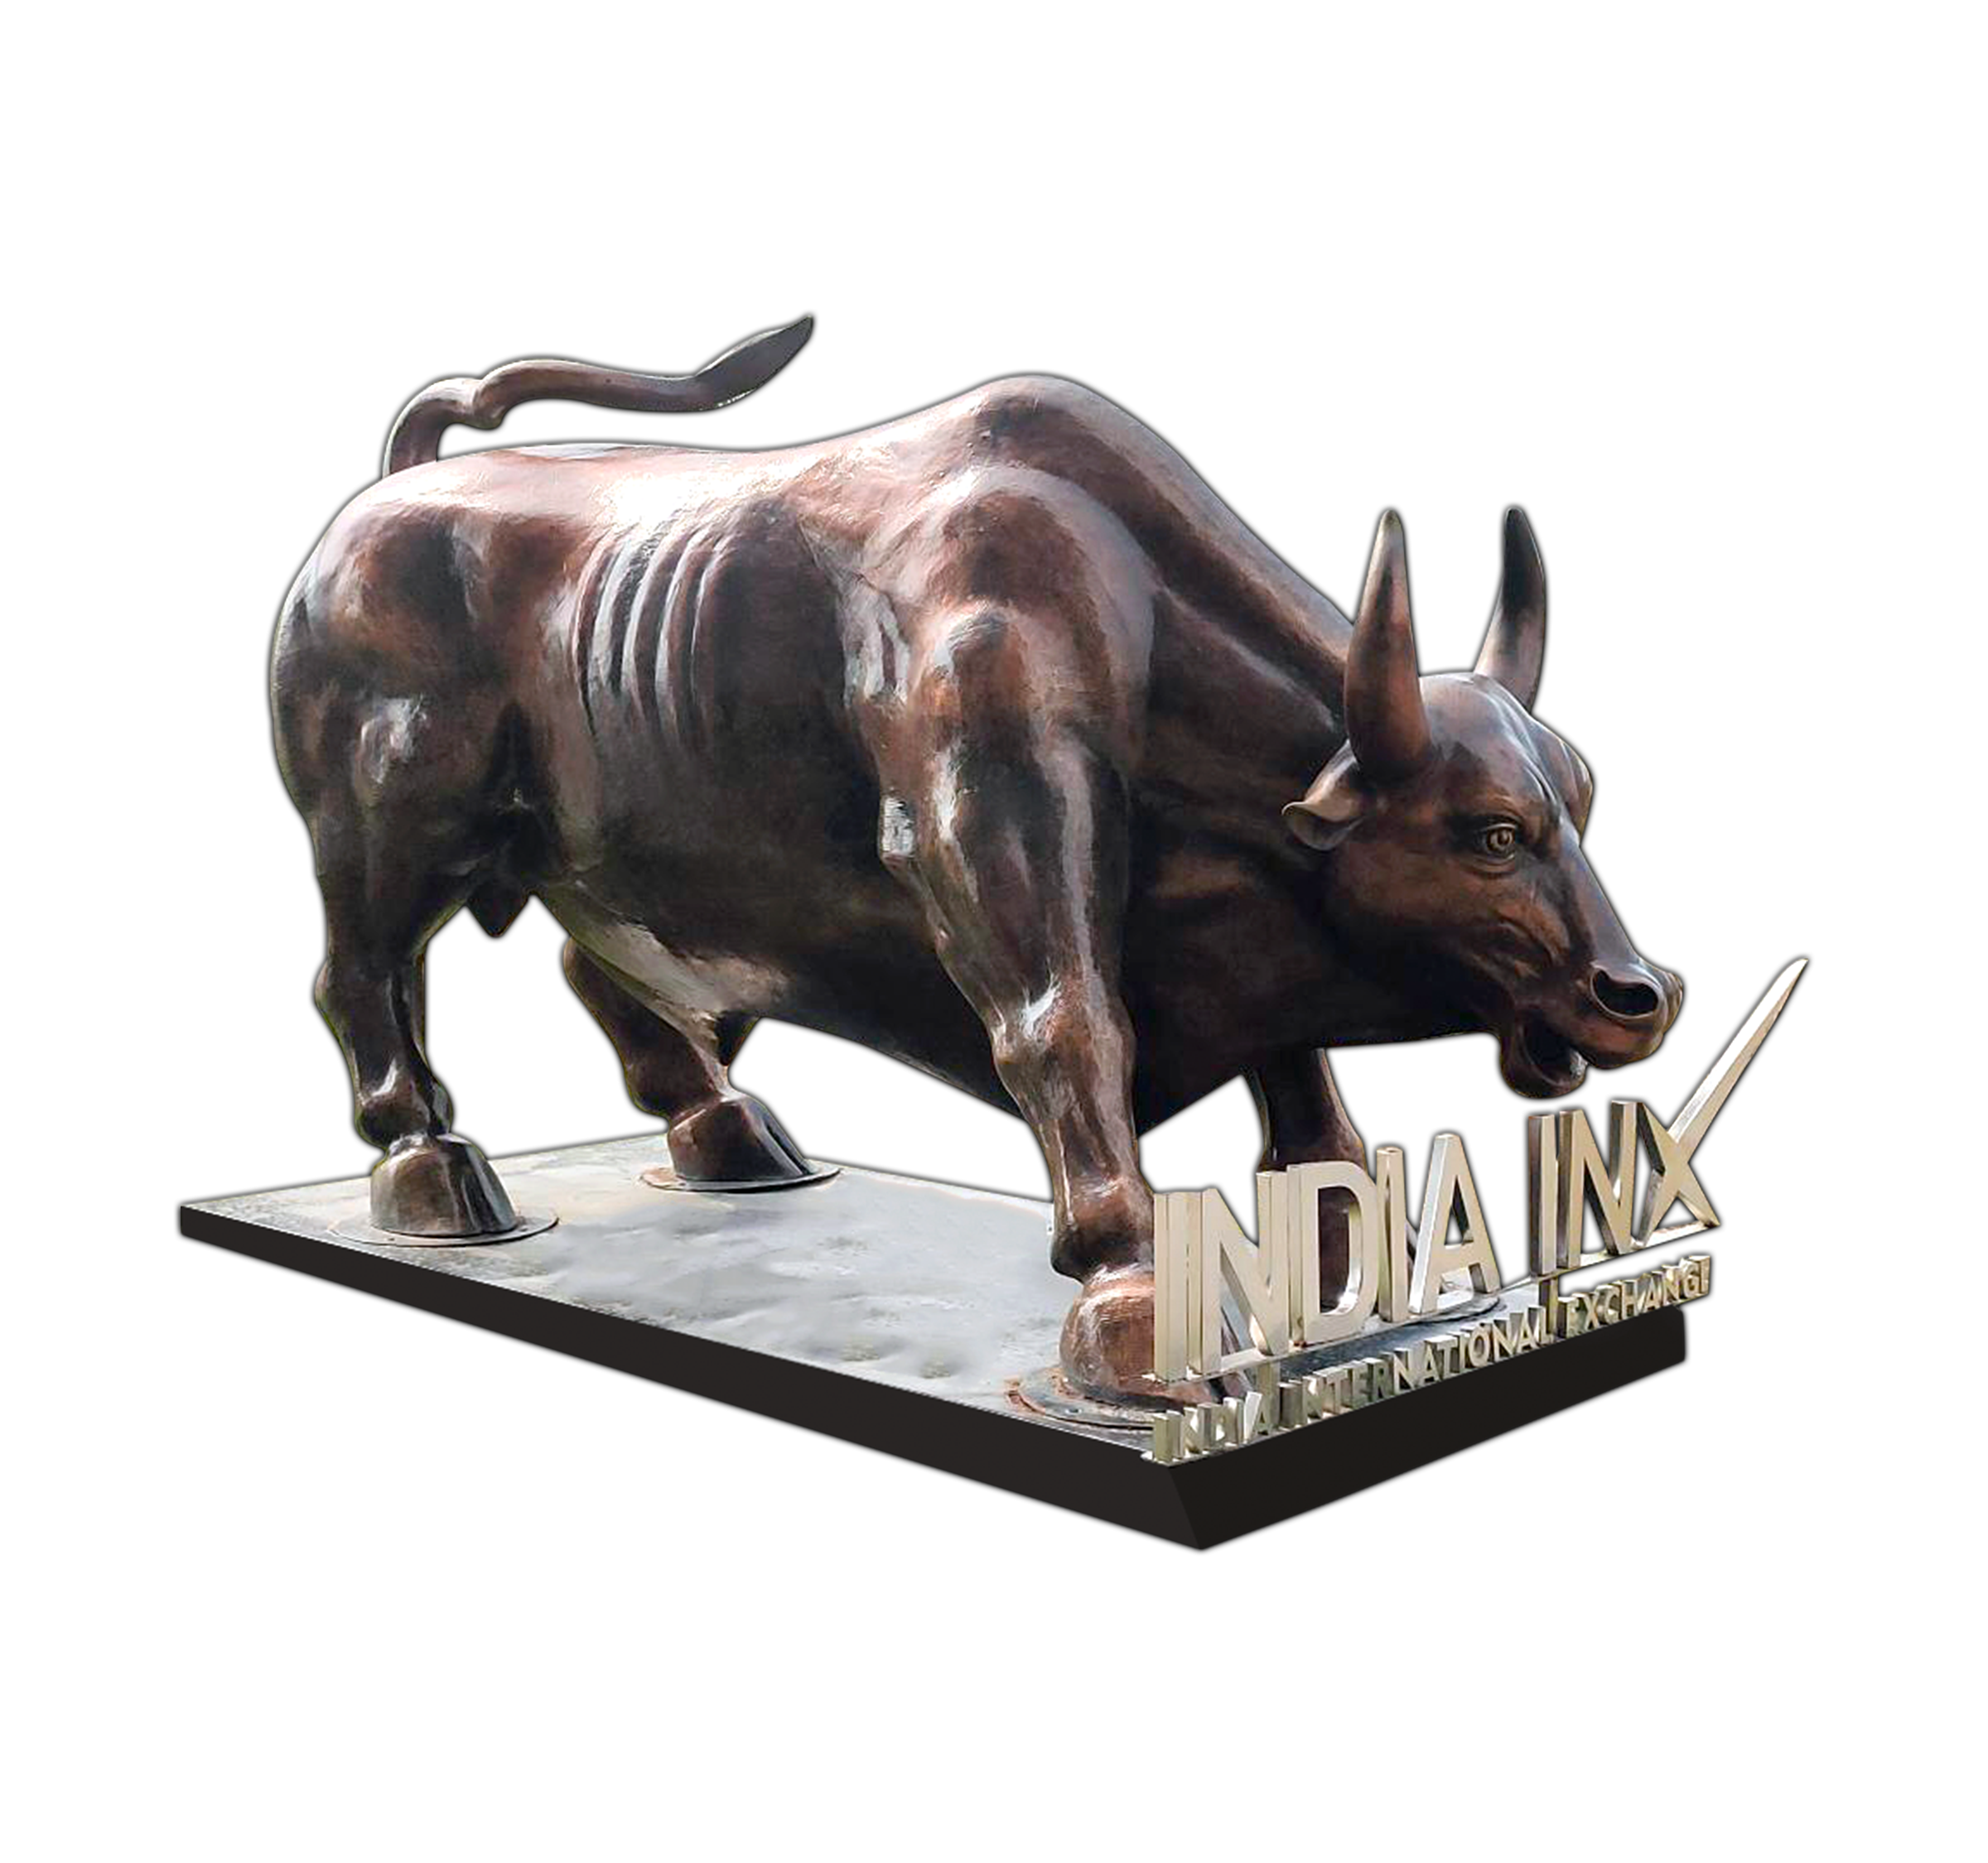
INDIA’S FIRST INTERNATIONAL EXCHANGE
YOUR BEST OFFSHORE GATEWAY

Slide 2
2 KEY VISION OUTLINED BY PM
AT THE LAUNCH OF INDIA INX
“My vision is, Gift city should become the price setter for at least a few of the largest traded instruments in the world, whether in commodities, currencies, equities, interest rates or any other financial instrument”
“..Companies from Asia, Africa and Europe should be able to raise funds from this important International Finance Centre”
Hon’ble Prime Minister , Shree Narendra Modi
on 9th Jan, 2017
at inauguration of India INX

Slide 3
1ST MOVER @ GIFT IFSC
1
TO LIST
150 DEBT SECURITIES
^{st}
To start derivatives trading in
GIFT IFSC
To list and trade debt product
in GIFT IFSC
To be
ISO certified
To launch dedicated green bonds platform
To Provide trading window of 22 HRS
To conduct live trading from DR site
EXCHANGE
AT GIFT IFSC

Slide 4
INDIA INX – PRODUCT PORTFOLIO
EQUITIES
DEBT
DERIVATIVES
Initial Public Offer
Direct listing of equities
Follow on Public Offer
Offer for Sale
Qualified Institutional Placement
Preferential Issue
Right Issue
REITs/InvITs
Depository Receipts
Foreign Currency Bonds
Masala Bonds – INR Denominated
ESG Labelled Bonds
Medium Term Note Programme
Supranational & Sovereign Bonds
Municipal Bonds
SGrB
CP & CD
Equity Index Derivatives
BSE SENSEX
Commodity Derivatives
Currency Derivatives
125+ Single Stock Futures

Slide 5
DIRECT LISTING OF EQUITY IN GIFT IFSC
Eligibility Criteria
Following entities are eligible to list their securities on a recognised stock exchange in IFSC:
Company incorporated in an IFSC
Company incorporated in India*
Company incorporated in a Foreign Jurisdiction
*IFSCA Regulations are in place to govern listing of unlisted as well as listed Indian corporates. However, for listing of corporates listed in domestic jurisdiction, operational framework from SEBI is awaited

Slide 6
IFSCA (Listing) Regulations, 2024
Key Highlights
Can list only with 10% dilution. No requirement to raise to 25%
No minimum number of investors prescribed
Issue can be open minimum for 1 day and max for 10 days
Unlisted Indian corporate:
To list only through book building process
Shall have positive net worth
Issue to be handled by Lead Manager (LM) registered with IFSCA
Discretion is given to the issuer / LM to decide on:
Categories of investors (e.g. QIBs/HNI/SH/Employee)
Methodology for allotment (e.g. Proportionate/ discretionary)
Mode of collection of subscription in IPO

Slide 7
LEADING AT GLOBAL SECURITIES MARKET
MTN Programme Established
$ 82+ Billion
Value of bonds listed
$ 60+ Billion
ESG Issuance
$ 14+ Billion
No. of unique ISIN listed
150
Unique issuers
56
Trading in Global Access
$ 1.5+ Billion
Derivatives Volume
$ 8.93 Trillion
Daily ADTV for FY 24-25
$ 206 Million

Slide 8
Listing NCDs in IFSC Versus ECBs in India
Cost Of Borrowing
Competitive Interest Rates
Lower Hedging Costs
Regulatory Flexibility
Flexible end Use
Faster Approval Process
Potential Tax Benefits
9% Witholding Tax
Lower Transaction Costs
India INX at GIFT IFSC provides an efficient, globally competitive alternative for PSU issuers to raise USD Funds compared to ECBS

Slide 9
PSU Contribution to Total Debt Issuances
57%
43%
$ 34+ Billion
$ 26+ Billion
Other Issuers
PSU’s
Public Sector Undertakings (PSUs) contribute significantly, accounting for 43% of the total debt issuances on India INX

Slide 10
GSM GREEN @ India INX

Slide 11
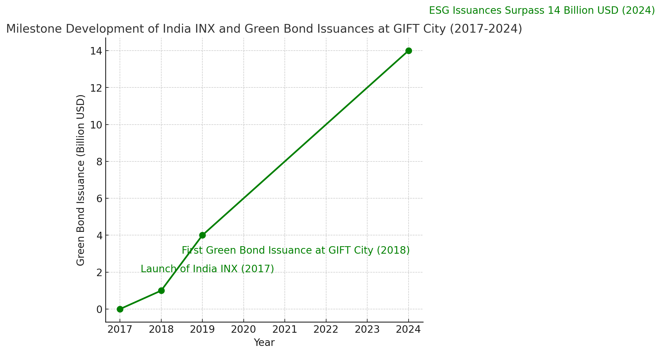
GSM GREEN @ India INX
GSM Green
$14+ Billion

Slide 12
GSM GREEN @ India INX
01
MOU with Luxembourg Stock Exchange
02
A Dedicated Green Listing platform
03
Introduction of SGrB through India INX

Slide 13
GIFT IFSC – Tax Competitiveness
GSM Green
No STT/CTT
No Capital Gains Tax
No Stamp duty
No GST
No Security transaction tax / No Commodity transaction tax
For Specified Securities
(units held by Non-residents)
No stamp duty on transaction carried out in IFSC exchanges
Zero Good & Services Tax (GST) on transactions carried out in IFSC exchanges
Tax Holiday
Minimum Alternative Tax (MAT)
Lower Withholding Tax
Additional Tax Benefits
10-year tax holiday on 100% of the profit for BUs in IFSC
9% of profit-booking, No MAT if assessee adopted new tax regime
9% on interest payments for bonds listed on IFSC Exchanges
Tax exemption on interest pay-out
No capital gain in relocation of capital asset, etc.

Slide 14
LISTED BOND UNIVERSE
USD 82+ Billion of MTN established
USD 60+ Billion of listed debt securities
Contact: listing.sales@indiainx.com

Slide 15
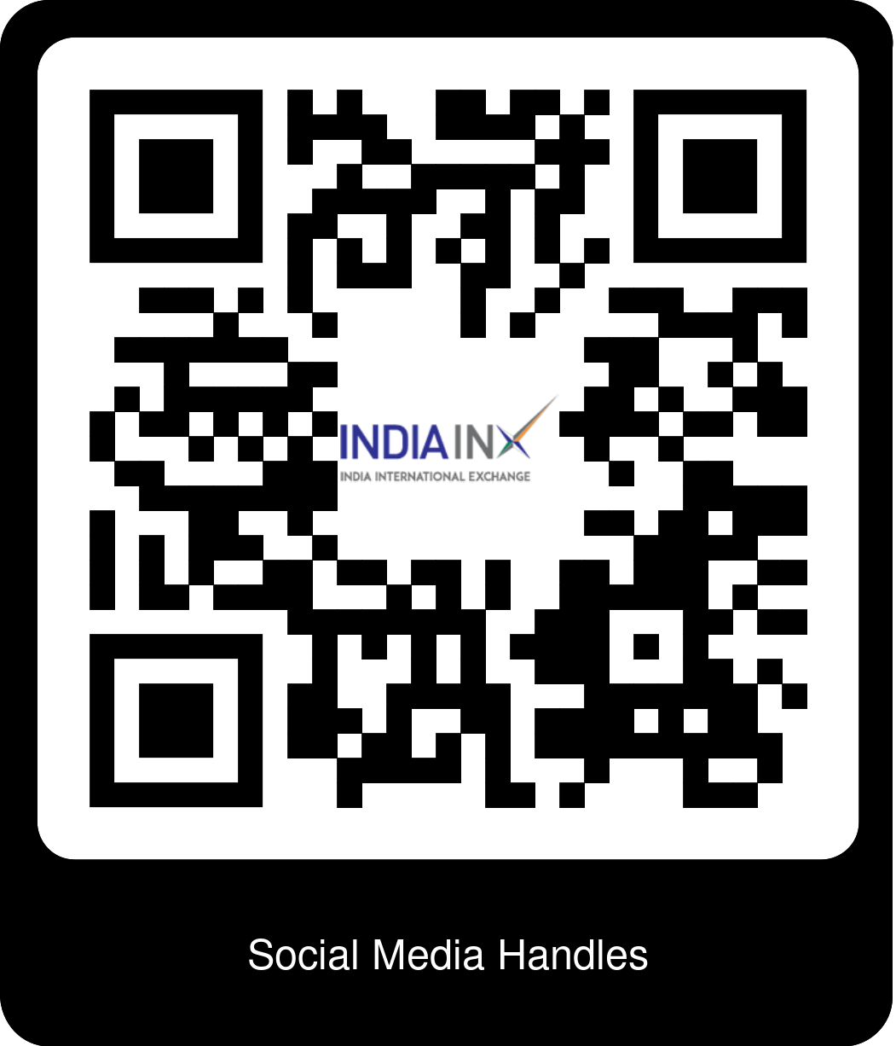
YOUR BEST OFFSHORE GATEWAY
For more details, please visit
http://www.indiainx.com
or write to us at
listing.sales@indiainx.com

Slide 16
DISCLAIMER
By accepting this document, you agree and accept with the representations made herein:
The material, logos, trademarks, data, information etc. (including third party data, logos, information etc.) included in this document or forming part of this documents have been compiled for general information purpose ONLY and neither create any legally binding obligation on the part of India International Exchange (IFSC) Limited (hereinafter referred to as the "INDIA INX") and / or its affiliates and/or third party nor reflects any endorsements by INDIA INX. Whilst making all reasonable efforts to provide correct and appropriate information and data, INDIA INX cannot and does not warrant or guarantee that the information and data provided in this document are accurate in every respect. All the information and data made available on this document is provided "AS IS" and "WITH ALL FAULTS", hence without warranty of any kind, other than when expressly provided in this document. INDIA INX does not warrant guarantee or make any representations concerning the use, results of use or inability to use the information available on this document in terms of the timeliness, truthfulness, sequence, completeness, accuracy, reliability, correctness, and performance or otherwise. The user of the information assumes the entire risk as to the suitability, use, results of use, accuracy, completeness, currentness of the information and shall waive any claim of detrimental reliance upon the information. The material and information provided in this document are neither intended to nor constitute an investment advice. While making a decision you should consider both your legal and regulatory position in the relevant jurisdiction and the risks associated with the transaction. By making the information and data available on this document INDIA INX is not acting as your legal, financial, tax or accounting advisor or in any other fiduciary capacity with respect to any transaction, of whatsoever nature. Without limitation, this document does not solicit or constitute an offer, an invitation to offer or a recommendation to enter into any transaction. Through this document, INDIA INX is neither soliciting business, generally or specifically, nor is it directing any work flow or recommendations to the Futures Commission Merchants, the Commodity Pool Operator, the Commodity Trading Advisor and Introducing Broker. INDIA INX its group companies and third parties whom any data, logo, etc. belongs in this documents specifically disclaims all liability for any direct, indirect, consequential or any other losses or damages including loss of profits incurred by you or any third party that may arise from any reliance on this document for the reliability, accuracy, completeness. All rights reserved. All content [texts, trademarks, illustrations, images, graphic representations, files, designs, arrangements and the literary work] on this document of INDIA INX, its group companies and/or third party are protected by the prevailing intellectual property laws, therefore the rights accruing from the same wholly vest with INDIA INX. However users are permitted to use the information by making copies, storing (internally) or reproducing the data provided in this document for their OWN PERSONAL USE and not commercial purposes. All other use, other than the above mentioned shall be considered to be in violation of the terms and conditions and would constitute an offence under the laws of India and the International treaties governing the same. Any dispute arising out of or in connection with the use of the information provided by this document is subject to the exclusive jurisdiction if the courts of Ahmedabad (Gujrat), India and shall be governed by the Indian Law.

