Slide 1
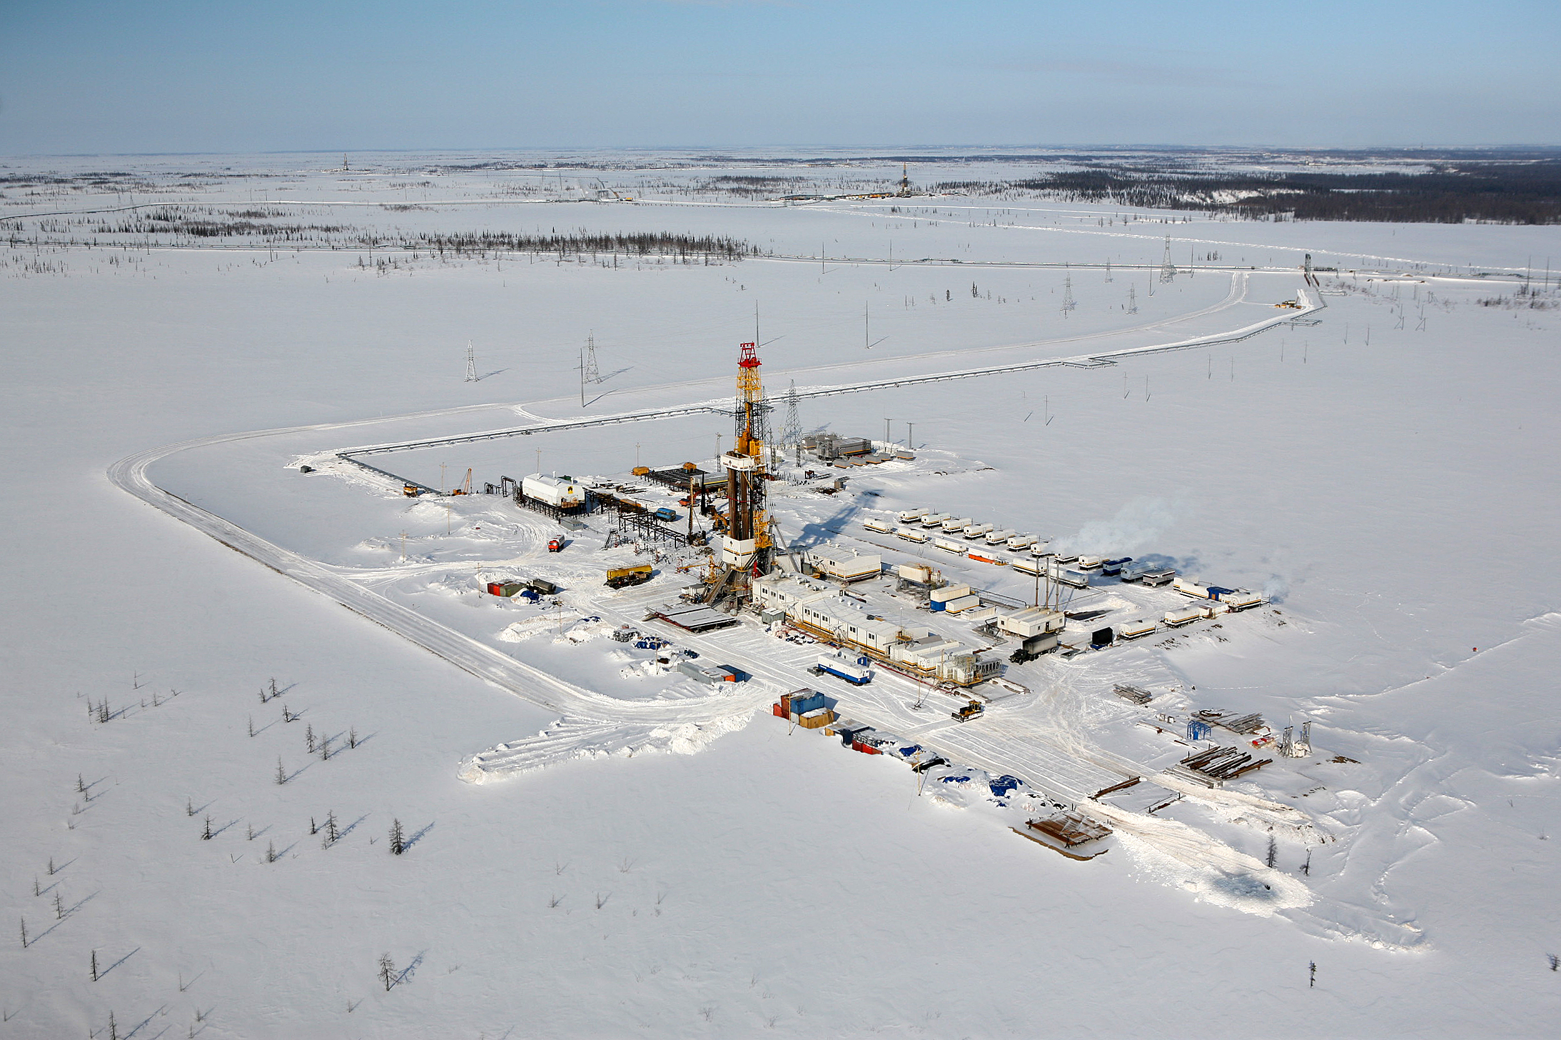
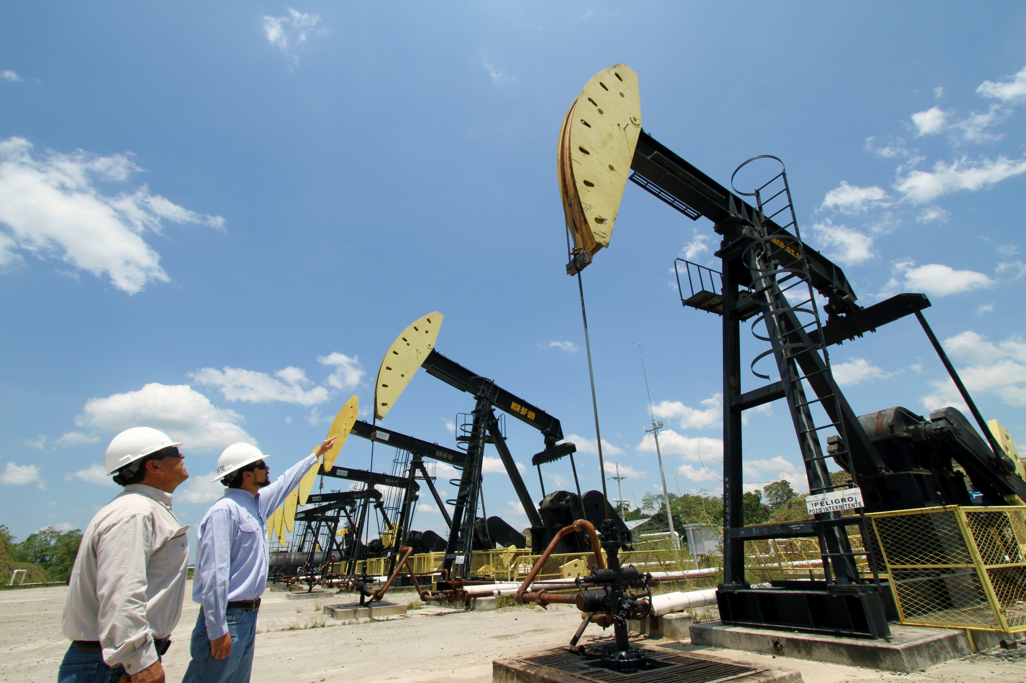
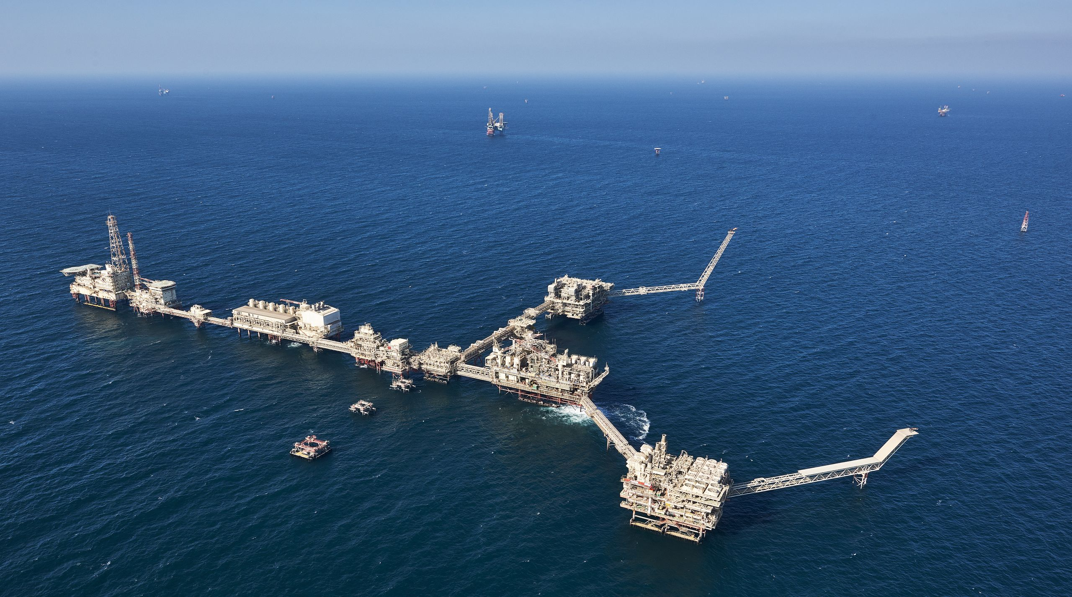
MECL Field
Lower Zakum Offshore Complex
Vankorneft Drill Site
ACG Platform
IFSCA CPSE Summit 2.0: Opportunities in GIFT IFSC
Experience Sharing by ONGC Videsh Limited
February 2025

Slide 2
Presentation Overview
1
Introduction of ONGC Videsh
2
Global Footprints
3
Reserves and Production
4
Global Partners
5
Experience @ GIFT IFSC
6
Enhancing attractiveness of GIFT IFSC

Slide 3
Presentation Overview
1
Introduction of ONGC Videsh
2
Global Footprints
3
Reserves and Production
4
Global Partners
5
Experience @ GIFT IFSC
6
Enhancing attractiveness of GIFT IFSC

Slide 4
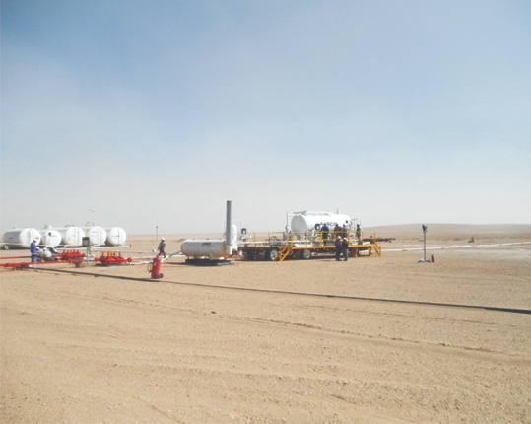
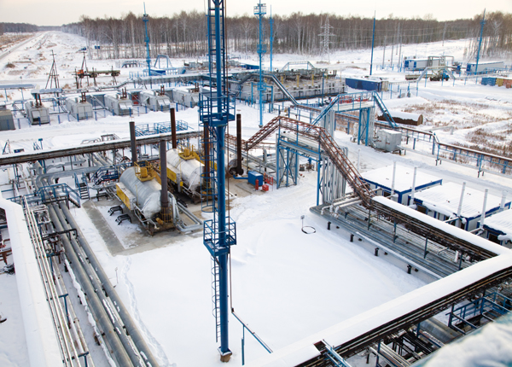
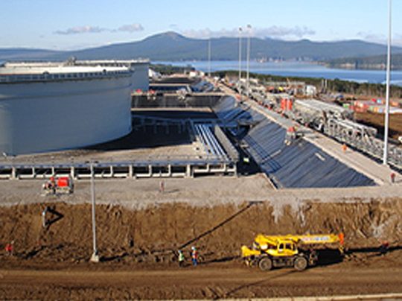
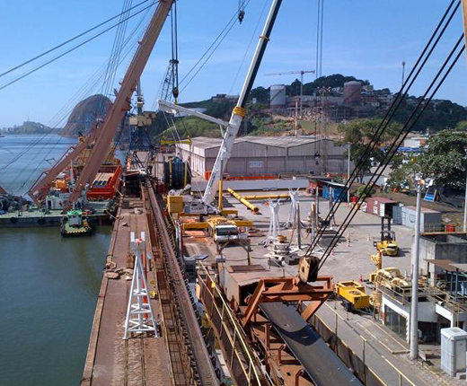
ONGC Videsh Limited – International E&P Company of India
476_125/ 482_176
MMTOE
5th March 1965
15th June 1989
19 Countries,
32 Assets
202 KBOE
Incorporated as Hydrocarbons India Pvt. Ltd.
Rechristened ONGC Videsh Ltd.
Avg. Daily Production in FY’24
2P_2C/3P_3C Reserves @01.04.2024
Global Presence

Slide 5
Key Strengths
Alliances & Partnership
with Global Oil Companies
Balanced Portfolio of E&P Assets
(Prod – Expl – Dev)
Strong Governance
Excellent Human Resource
Extensive International Footprint
Technology as Value Driver

Slide 6
Presentation Overview
1
Introducing ONGC Videsh
2
Global Footprints
3
Reserves and Production
4
Global Partners
5
Experience @ GIFT IFSC
6
Enhancing attractiveness of GIFT IFSC

Slide 7
Global Footprints
32 projects in 15 countries
Producing: 14
Discovered/ Developing: 4
Exploration: 11
Pipeline: 3
Russia BU
Russia | 3
AP BU
Colombia BU
Vietnam | 1 |  | 1
Myanmar | 2 |  | 2 | 2
Bangladesh |  |  | 2
Colombia | 1 |  | 3
LAC BU
Venezuela | 1 | 1
Brazil | 1 |  | 1
MENA-CIS BU
MOZAMBIQUE BU
Azerbaijan | 1 |  |  | 1
UAE | 1
South Sudan | 2
Mozambique |  | 1
Business Excellence Centres
Dormant Projects: 5
Business Presence in 19 Countries across 5 Continents

Slide 8
Presentation Overview
1
Introduction of ONGC Videsh
2
Global Footprints
3
Reserves and Production
4
Global Partners
5
Experience @ GIFT IFSC
6
Enhancing attractiveness of GIFT IFSC

Slide 9
2P Reserves Spread
476.329 MMToE as on 01.04.2024

Slide 10
Production vis-à-vis National Production
Source : PPAC

Slide 11
ONGC Videsh: 2nd Largest E&P Company
Contributes ~21% of ONGC's total O&G production
2nd largest Indian upstream company after parent …
… and 2nd largest Indian player by reserves
Production in MMTOE
Production in MMTOE
2P Reserves (MMTOE)
FY’24
50.5
ONGC
41.8
ONGC
Only company producing from operated assets overseas
FY’22
52.8
OVL
10.5
OVL
FY’20
59.6
OIL
8.7
OIL
FY’18
60.0
IOCL
IOCL
FY’16
52.4
BPRL
2.6
GAIL
FY’14
53.9
OVL
ONGC
Domestic
International
HPCL
0

Slide 12
Presentation Overview
1
Introduction of ONGC Videsh
2
Global Footprints
3
Reserves and Production
4
Global Partners
5
Experience @ GIFT IFSC
6
Enhancing attractiveness of GIFT IFSC

Slide 13
Global Partners
Partnerships with leading IOCs/NOCs worldwide

Slide 14
Presentation Overview
1
Introduction of ONGC Videsh
2
Global Footprints
3
Reserves and Production
4
Global Partners
5
Experience @ GIFT IFSC
6
Enhancing attractiveness of GIFT IFSC

Slide 15
Fast Approval
With the effective support of IFSCA and SEZ, ONGC Videsh was able to get OVL Overseas IFSC Limited going in record time
IFSCA (in-principle)
18 Dec – 2023
Niti Ayog
14 Nov – 2023
MCA – Inc. Certificate
07 Dec – 2023
SEZ
28 Dec – 2023
11 Days
21 Days
~45 Days

Slide 16
Experience @ GIFT IFSC
Advantages from onshoring the offshore
Same time zone, effective co-ordination
Better control, no POEM risk
Easier manpower availability and labour law compliances
Lower G&A costs
Free flow of funds & flexibilities in borrowings – FEMA & ECB guidelines inapplicable
Fair & friendly regulator with ear to the ground - Light touch regulations
Fiscal advantages –
No WHT on interest to offshore lenders
No GST on guarantee fees and other services/goods procured
10-year income tax holiday
Thin capitalization rule does not apply to IFSC entities
No stamp duty, STT & CTT
Consolidation with Indian group for Global Minimum Tax purposes

Slide 17
Presentation Overview
1
Introduction of ONGC Videsh
2
Global Footprints
3
Reserves and Production
4
Global Partners
5
Experience @ GIFT IFSC
6
Enhancing attractiveness of GIFT IFSC

Slide 18
Enhancing attractiveness of GIFT IFSC
Permission to hold Participating Interests
Aligning tax regime with global financial centres
PSU subsidiaries not to be Government companies
Exemption from large borrower framework
Inapplicability of ECB guidelines to borrowings by Indian entity from treasury centre in GIFT IFSC
Relocating Indian entities carrying on overseas businesses to GIFT IFSC

Slide 19
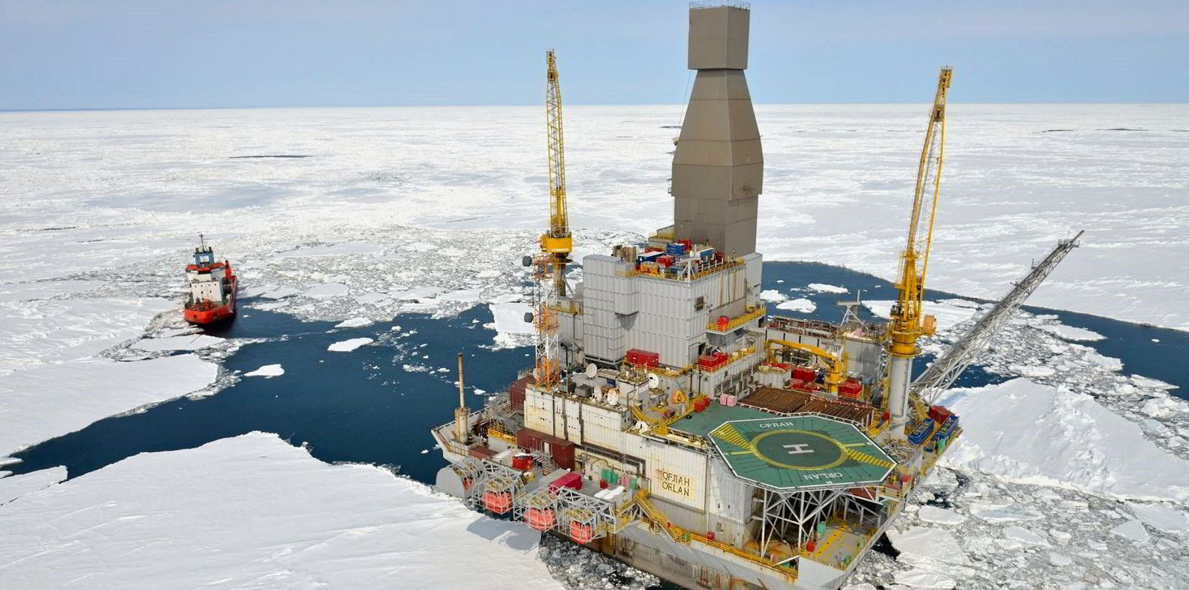
Thank you

