Slide 1



Aircraft Lease

Slide 2


The India Opportunity

Slide 3






Maximising the India Opportunity
Fastest Growing Large Economy & Stable Democracy
Key Achievements
Key Achievements
GDP currently at USD 3.94 Tn
Exports of USD 779 Bn in FY23-24
77 years of Democracy
Strong Institutions – Parliament, Media, Judiciary
High Real GDP Growth Rate of
8.2% FY 23-24
Youngest population : 65% of population under 35 years of age
5th largest economy;
To be 3rd largest by FY28
Average real income of citizens has increased by 50% in the last decade
Gross FDI inflows reached
USD 70.09 Bn in FY 24
Manufacturing sector contributed 15% to Nominal GVA in Q4, FY 24

Slide 4





Viksit Bharat@2047 – Developed India@2047
Inclusive Sustainable Growth for the World’s Largest Democracy
Potential Growth of 7+% over next 25 years
Per Capita Income to grow 9x to ~USD 22,000
USD 35 Trillion
Projected Economy
Industry share to rise from 17%→25% of GDP
Exports to grow x5 to USD 8 Tn. by 2047
Net Zero Transition by 2070: USD 10 Tn

Slide 5

GIFT City and IFSC Opportunity

Slide 6
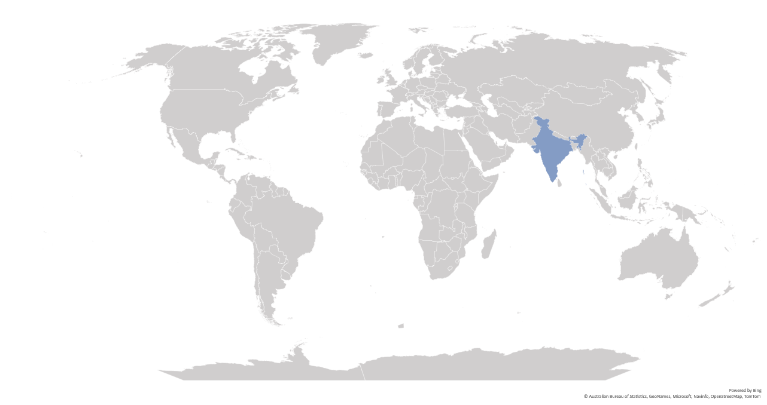
IFCs catering to India’s demand for International Financial Services
GIFT IFSC: Onshoring the Offshore International Financial Services
Aircraft Leasing
Ireland
Reinsurance, NDF, Bonds
UK
Funds
USA
Luxembourg
NRI, Ship leasing
Cayman Islands
Dubai
Debt
Capital Markets
Hong Kong
GIFT IFSC
Funds
Singapore
Funds
Funds, ECB
Mauritius
Key financial services being availed from overseas jurisdictions
Banking Services: ECB, Trade Finance, Non-Deliverable Forwards & Loan syndication
Funds Industry: Pooling of global capital by Pvt. Equity/ VC Funds/ Hedge Funds for investments into India
Capital Mkts: Issuance & listing of Bonds including ESG bonds, trading of Indian securities & products
Insurance: Reinsurance business
Aircraft & Ship Leasing business

Slide 7
Objectives of GIFT IFSC
Onshore international financial services business from offshore centres such as Singapore, Hong Kong, Dubai, London, etc.
Serve as a dominant gateway for channelizing global capital for Viksit Bharat @ 2047
Develop expertise in niche and specialized businesses such as aircraft & ship leasing, fintech, global treasury centres, commodity trading, etc.
Provide high quality employment opportunities to the talented Indian workforce
1
Aims & Objectives
2
3
4

Slide 8
GIFT City and IFSC
India's 1st Operational Smart City & IFSC
27.70 Mn Sq ft
12.99 Mn Sq ft
20
Total development
rights allotted
Area under
development
Number of Operational Buildings
GIFT City is divided into two zones:
Special Economic Zone (IFSC Zone)
Domestic Tariff Area (Domestic area)
Greenfield smart city
Land parcel size: 886 acres
Social Infra – Hotels, Hospitals, Schools, etc
‘Walk to work concept’ – Residential & Riverside

Slide 9
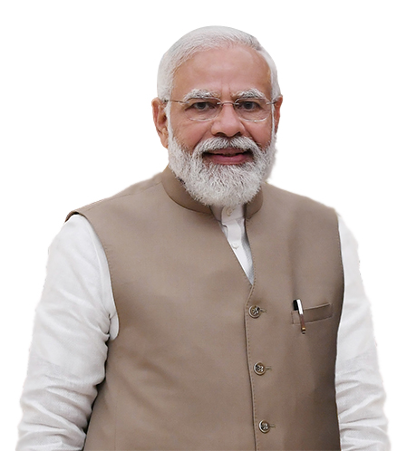

Vision for GIFT IFSC
“We want to make GIFT City the Global Nerve Center of New Age Global Financial and Technology Services”
“GIFT IFSC's cutting-edge digital infrastructure provides a platform that enables businesses to increase efficiency”
“GIFT City is an important gateway to connect India with global opportunities….
Hon’ble Prime Minister of India
Sh. Narendra Modi

Slide 10
Jurisdictional Comparison
Foreign jurisdiction (rest of the world) | IFSC SEZ (India) | India DTA (India)
Offshore Non-Resident | Offshore Non-Resident | Onshore Resident
Respective Int’l Currency | 15 Currencies (INR Not Permitted) | INR denominated
Offshore | Tax Holiday (Tax Resident) | Taxes as applicable
Resident’s Jurisdiction | Indian Jurisdiction | Indian Jurisdiction
Jurisdiction
FEMA
Currency
Tax
Law

Slide 11


GIFT IFSC: Unique and Distinct Features
Dedicated & Unified Financial Regulator
No capital controls
Full Convertibility with 15 foreign currencies
Globally benchmarked regulations
Attractive Tax Regime
Sovereign support, including carve outs
Competitive Advantage
  Access to large hinterland Indian economy (Hinterland advantage)
  Beneficial cost of operations (Cost advantage)
  Availability of skilled talent pool (Talent advantage)

Slide 12

Competitive tax regime
1
Tax Holiday on Business Income for 10 out of 15 years
2
Minimum Alternate Tax* @ 9%
3
No CTT**/STT**/GST**/Stamp Duty
4
Reduced Withholding Tax of 9% on interest paid on Debt Instruments
5
Competitive Tax Regime for Funds
6
Incentives under Gujarat IT/ITeS Policy (2022-27)
*MAT provisions not applicable for companies opting for concessional tax rate under Sec. 115 BA of Income Tax Act, 1961
**CTT- Commodity Transaction Tax, STT- Securities Transaction Tax, GST- Goods and Service Tax
Notes:
GIFT City – Brief

Slide 13
IFSC: Business activities
Banking
Capital Market
Asset management
lndian Banks (16)
Foreign Banks (12)
Global Administrative Office (1)
Rep. Offices
Stock Exchanges (2)
Clearing Corporation (2)
International Depository (1)
Broker Dealers (82)
Investment Bankers (3)
Custodians (5)
Depository Participants (10)
Clearing members (22)
Fund Management Entities (137)
Alternate Investment Funds (189)
Investment Advisers (3)
Portfolio Managers (19)
Distributors (10)
Insurance
Niche Institutions
Emerging businesses
Indian & Foreign Insurer (12)
Indian & Foreign Reinsurer (3)
Insurance Intermediaries (24)
Insurance Web-Aggregators
International Bullion Exchange
Finance Companies (6)
Global Treasury Centre (3)
ITFS Platform (4)
Aircraft Leasing & Financing (32)
Ship Leasing & Financing (21)
Foreign Universities (2)
Global Fintech Hub (57)
Global in-House Centres (3)
Professional Service Providers (83)
Payment Service Providers (2)
BATF Service Provider
Figures in brackets are the number of entities authorized by IFSCA
Notes:
GIFT City – Brief

Slide 14
Business Highlights: GIFT IFSC
725 +
$ 87 Bn
$ 71 Bn
Number of IFSCA Registered* Entities till Nov. 2024
Monthly turnover on IFSC International Stock Exchanges in Nov. 2024
Total Banking Asset Size in Nov. 2024
137
$ 63 + Bn
$ 1048 Bn
Number of Funds Management Entities registered till Nov. 2024
Cumulative Debt Listing on IFSC Exchanges till Nov. 2024
Cumulative Banking transactions till Nov. 2024
184
$ 45 + Bn
$ 40 Bn
Total targeted corpus of Alternative Investment Funds till Nov. 2024
Aviation Assets leased from IFSC till Nov. 2024
Derivative Transactions booked by banks in Nov. 2024

Slide 15

Regulatory Framework for Aircraft Lease in IFSC
Aircraft leasing is regulated under IFSCA (Finance Company) Regulation, 2021, and entities are allowed to register as aircraft lessor under ‘Framework for Aircraft Lease’.
“Aircraft Lessor” is an entity engaged in the business of providing aircraft or helicopter and engines of aircraft or helicopter or any other part thereof and/or aircraft ground support equipment and/or aviation training simulation device under an operating lease, financial lease and/or a hybrid of the financial and operating lease.
MODE OF BUSINESS:
Aircraft leasing entity can be set up as a Company or an LLP or a Trust or any other form as may be speciﬁed by the IFSCA.
The promoter of the applicant shall be located in a Financial Action Task Force (FATF) compliant jurisdiction.
SHARING OF OFFICE SPACE AND MANPOWER:
IFSC aircraft lessor is permitted to share office space or manpower or both with another aircraft lessor being a group entity.

Slide 16
Key Provisions of the Framework for Aircraft Lease in IFSC:
PERMISSIBLE ACTIVITIES:
Financial lease, operating lease or a hybrid of ﬁnancial and operating lease, including sale and leaseback, purchase, novation, transfer, assignment, and such other similar transactions in relation to Aircraft lease;
Asset Management Support Services for assets owned or leased out by the lessor or by any of its Group Entities set up in IFSCs in India;
Any other related activity with the prior approval of the IFSCA.
CAPITAL REQUIREMENT:
A minimum owned fund of USD 200,000 or its equivalent for Operating lease and USD 3,000,000 or its equivalent for Financial lease or hybrid lease.
The owned fund requirement is to be met before commencing business and a time period of 6 months is provided from the date grant of provisional registration for infusing the funds.
CURRENCY:
The entity can deal in any freely convertible foreign currency as speciﬁed by IFSCA and is permitted to defray its administrative expenses in INR.

Slide 17
Setting up an Aircraft leasing Entity in IFSC
The entity applies in SWIT
Based on complete information, provisional registration granted, subject to the conditions specified
Registration is granted, post fulfillment of conditions specified above
Commencement of operations of Aircraft lessors

Slide 18
THANK YOU

