Slide 1



International Trade
Finance Services Platform

Slide 2


The India Opportunity

Slide 3






Maximising the India Opportunity
Fastest Growing Large Economy & Stable Democracy
Key Achievements
Key Achievements
GDP currently at USD 3.94 Tn
Exports of USD 779 Bn in FY23-24
77 years of Democracy
Strong Institutions – Parliament, Media, Judiciary
High Real GDP Growth Rate of
8.2% FY 23-24
Youngest population : 65% of population under 35 years of age
5th largest economy;
To be 3rd largest by FY28
Average real income of citizens has increased by 50% in the last decade
Gross FDI inflows reached
USD 70.09 Bn in FY 24
Manufacturing sector contributed 15% to Nominal GVA in Q4, FY 24

Slide 4





Viksit Bharat@2047 – Developed India@2047
Inclusive Sustainable Growth for the World’s Largest Democracy
Potential Growth of 7+% over next 25 years
Per Capita Income to grow 9x to ~USD 22,000
USD 35 Trillion
Projected Economy
Industry share to rise from 17%→25% of GDP
Exports to grow x5 to USD 8 Tn. by 2047
Net Zero Transition by 2070: USD 10 Tn

Slide 5

GIFT City and IFSC Opportunity

Slide 6
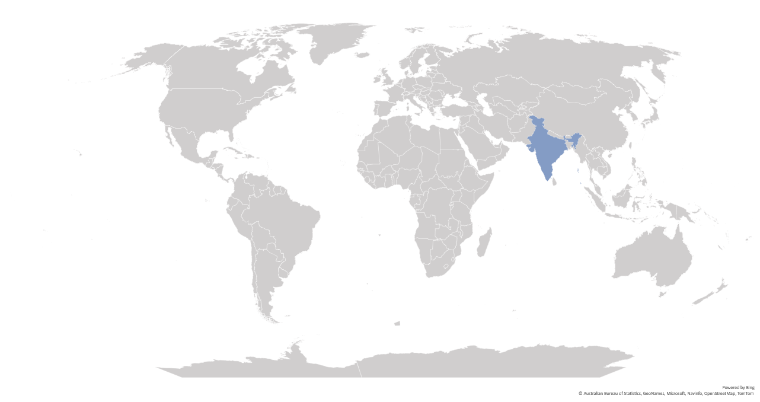
IFCs catering to India’s demand for International Financial Services
GIFT IFSC: Onshoring the Offshore International Financial Services
Aircraft Leasing
Ireland
Reinsurance, NDF, Bonds
UK
Funds
USA
Luxembourg
NRI, Ship leasing
Cayman Islands
Dubai
Debt
Capital Markets
Hong Kong
GIFT IFSC
Funds
Singapore
Funds
Funds, ECB
Mauritius
Key financial services being availed from overseas jurisdictions
Banking Services: ECB, Trade Finance, Non-Deliverable Forwards & Loan syndication
Funds Industry: Pooling of global capital by Pvt. Equity/ VC Funds/ Hedge Funds for investments into India
Capital Mkts: Issuance & listing of Bonds including ESG bonds, trading of Indian securities & products
Insurance: Reinsurance business
Aircraft & Ship Leasing business

Slide 7
Objectives of GIFT IFSC
Onshore international financial services business from offshore centres such as Singapore, Hong Kong, Dubai, London, etc.
Serve as a dominant gateway for channelizing global capital for Viksit Bharat @ 2047
Develop expertise in niche and specialized businesses such as aircraft & ship leasing, fintech, global treasury centres, commodity trading, etc.
Provide high quality employment opportunities to the talented Indian workforce
1
Aims & Objectives
2
3
4

Slide 8
GIFT City and IFSC
India's 1st Operational Smart City & IFSC
27.70 Mn Sq ft
12.99 Mn Sq ft
20
Total development
rights allotted
Area under
development
Number of Operational Buildings
GIFT City is divided into two zones:
Special Economic Zone (IFSC Zone)
Domestic Tariff Area (Domestic area)
Greenfield smart city
Land parcel size: 886 acres
Social Infra – Hotels, Hospitals, Schools, etc
‘Walk to work concept’ – Residential & Riverside

Slide 9
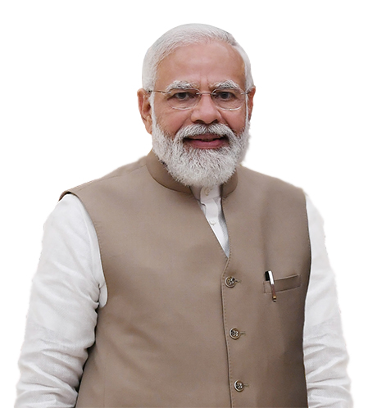

Vision for GIFT IFSC
“We want to make GIFT City the Global Nerve Center of New Age Global Financial and Technology Services”
“GIFT IFSC's cutting-edge digital infrastructure provides a platform that enables businesses to increase efficiency”
“GIFT City is an important gateway to connect India with global opportunities….
Hon’ble Prime Minister of India
Sh. Narendra Modi

Slide 10
Jurisdictional Comparison
Foreign jurisdiction (rest of the world) | IFSC SEZ (India) | India DTA (India)
Offshore Non-Resident | Offshore Non-Resident | Onshore Resident
Respective Int’l Currency | 15 Currencies (INR Not Permitted) | INR denominated
Offshore | Tax Holiday (Tax Resident) | Taxes as applicable
Resident’s Jurisdiction | Indian Jurisdiction | Indian Jurisdiction
Jurisdiction
FEMA
Currency
Tax
Law

Slide 11


GIFT IFSC: Unique and Distinct Features
Dedicated & Unified Financial Regulator
No capital controls
Full Convertibility with 15 foreign currencies
Globally benchmarked regulations
Attractive Tax Regime
Sovereign support, including carve outs
Competitive Advantage
  Access to large hinterland Indian economy (Hinterland advantage)
  Beneficial cost of operations (Cost advantage)
  Availability of skilled talent pool (Talent advantage)

Slide 12

Competitive tax regime
1
Tax Holiday on Business Income for 10 out of 15 years
2
Minimum Alternate Tax* @ 9%
3
No CTT**/STT**/GST**/Stamp Duty
4
Reduced Withholding Tax of 9% on interest paid on Debt Instruments
5
Competitive Tax Regime for Funds
6
Incentives under Gujarat IT/ITeS Policy (2022-27)
*MAT provisions not applicable for companies opting for concessional tax rate under Sec. 115 BA of Income Tax Act, 1961
**CTT- Commodity Transaction Tax, STT- Securities Transaction Tax, GST- Goods and Service Tax
Notes:
GIFT City – Brief

Slide 13
IFSC: Business activities
Banking
Capital Market
Asset management
lndian Banks (16)
Foreign Banks (12)
Global Administrative Office (1)
Rep. Offices
Stock Exchanges (2)
Clearing Corporation (2)
International Depository (1)
Broker Dealers (82)
Investment Bankers (3)
Custodians (5)
Depository Participants (10)
Clearing members (22)
Fund Management Entities (137)
Alternate Investment Funds (189)
Investment Advisers (3)
Portfolio Managers (19)
Distributors (10)
Insurance
Niche Institutions
Emerging businesses
Indian & Foreign Insurer (12)
Indian & Foreign Reinsurer (3)
Insurance Intermediaries (24)
Insurance Web-Aggregators
International Bullion Exchange
Finance Companies (6)
Global Treasury Centre (3)
ITFS Platform (4)
Aircraft Leasing & Financing (32)
Ship Leasing & Financing (21)
Foreign Universities (2)
Global Fintech Hub (57)
Global in-House Centres (3)
Professional Service Providers (83)
Payment Service Providers (2)
BATF Service Provider
Figures in brackets are the number of entities authorized by IFSCA
Notes:
GIFT City – Brief

Slide 14
Business Highlights: GIFT IFSC
725 +
$ 87 Bn
$ 71 Bn
Number of IFSCA Registered* Entities till Nov. 2024
Monthly turnover on IFSC International Stock Exchanges in Nov. 2024
Total Banking Asset Size in Nov. 2024
137
$ 63 + Bn
$ 1048 Bn
Number of Funds Management Entities registered till Nov. 2024
Cumulative Debt Listing on IFSC Exchanges till Nov. 2024
Cumulative Banking transactions till Nov. 2024
184
$ 45 + Bn
$ 40 Bn
Total targeted corpus of Alternative Investment Funds till Nov. 2024
Aviation Assets leased from IFSC till Nov. 2024
Derivative Transactions booked by banks in Nov. 2024

Slide 15
Key highlights from guidelines on Setting up and operation on ITFS platform
Applicability:
To ITFS operators registered with IFSC prior to the issuance of the new guidelines issued on December 23, 2024.
To an entity desirous of seeking registration as an ITFS operator in IFSC, and
To the participants in an ITFS
Mode of business:
An Entity desirous of setting up as an ITFS operator shall be set up in the form of a newly incorporated company under the Companies Act, 2013
The applicant’s parent entity should have at least three years of experience in operating trading infrastructure in financial markets or operating a financial technology (fintech) platform.
Technical criteria:
An entity desirous of setting up an ITFS shall have sound technological infrastructure such as electronic platform for all participants, Management Information System (MIS) , and online surveillance capability to monitor positions, prices and volumes in real time to support its operations.
Capital Requirement:
Shall meet the minimum owned fund requirement of USD 0.2 million at all times.
.

Slide 16
Key highlights from guidelines on Setting up and operation on ITFS platform
Permissible Activities:
Acts as a facilitator for transactions relating to
    Factoring
    Reverse Factoring
    Bill discounting under Letter of Credit
    Supply chain Financing
    Pre-shipment Credit
    Forfaiting any other activity as permitted by the Authority
It can undertake Secondary Market transactions for the above products.
Undertake any permitted activity, with prior permission from the Authority.
Participants
    Exporters
    Importers
    Financiers
    Insurance/Credit Guarantee Institutions
    Payment Service Providers (PSP) or any other entity permitted by the IFSCA.
.

Slide 17
Key highlights from guidelines on Setting up and operation on ITFS platform
Principles of Operations:
(1) ITFS operator shall ensure that financiers on-boarded as participants satisfy the following criteria:
    Assets Under Management (AUM) or gross loans and advances made in the current or previous financial year shall be a minimum of USD 5 million;
    at least USD 5 million of capital;
    Proven capability for credit/debt recovery and credible management team with credit and collection experience;
    Must be an incorporated entity carrying out the business of factoring, which along with its shareholders, shall be from a FATF-compliant jurisdiction.
(2) The ITFS operator should comply with the following criteria:
    Applicable provisions of the IFSCA (AML, CFT and KYC) Guidelines, 2022;
    Enable transparent bidding on the platform.
    It shall not assume any credit risk on the transactions carried out on its platform;
    Legal proceedings initiated by the financier/s or the participant/s shall be outside the purview of the ITFS.
    It may connect with any other electronic platform/market infrastructure, with prior approval
    Shall establish a Complaint Handling and Grievance Redressal mechanism
.

Slide 18
Key highlights from guidelines on Setting up and operation on ITFS platform
Risk Management:
An ITFS operator shall put in place a comprehensive risk management framework covering all aspects of its operations.
Outsourcing:
The ITFS operator may tie up with technology providers, system integrators and other entities for on-boarding participants.
Currency of operations:
The ITFS Operator shall maintain its books of accounts, records and documents in USD.
Transactions on the ITFS may be settled in any specified foreign currency.
ITFS operator may open SNRR account under the provisions of section 1 of schedule 4 of the Foreign Exchange Management (Deposit) Regulations, 2016, as amended.
Clearing and Settlement:
An ITFS operator intending to provide clearing and/or settlements of fund shall seek authorization from IFSCA as a payment system operator under the IFSCA (Payment and Settlement Systems) Regulations, 2024.
.

Slide 19
Setting up a ITFS entity in IFSC
The newly incorporated entity in IFSC applies through SWIT
Based on complete information, provisional registration granted, subject to the conditions specified
Registration is granted, post fulfillment of conditions specified above
Commencement of operations of ITFS entity

